Slide 1
0x202 – Confidentiality
ECED4406 – Computer Security
Dr. Colin O’Flynn
Dalhousie University.

Slide 2
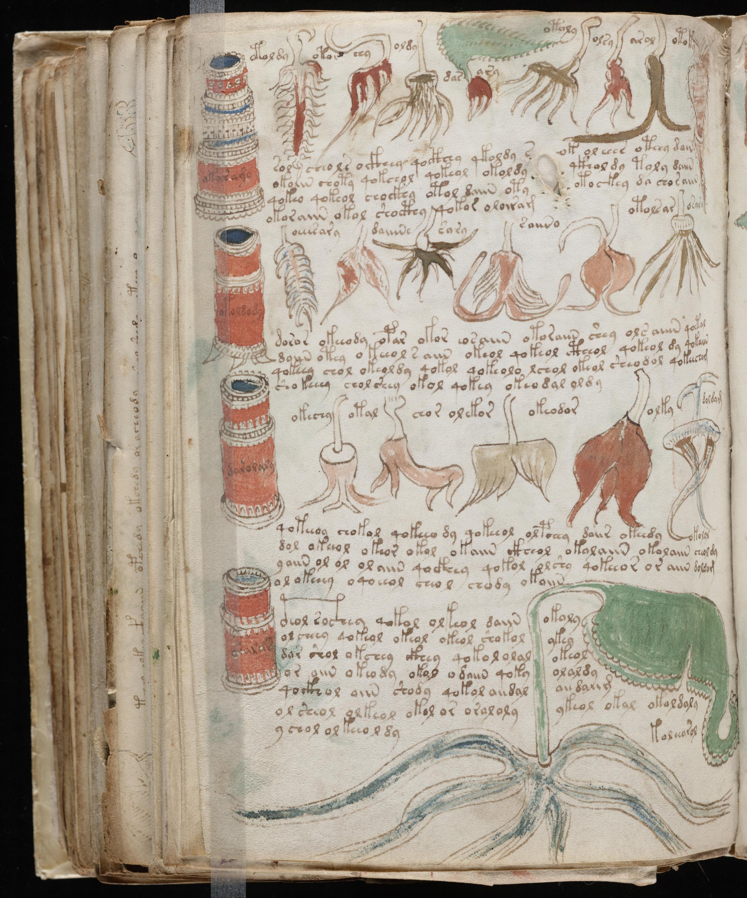

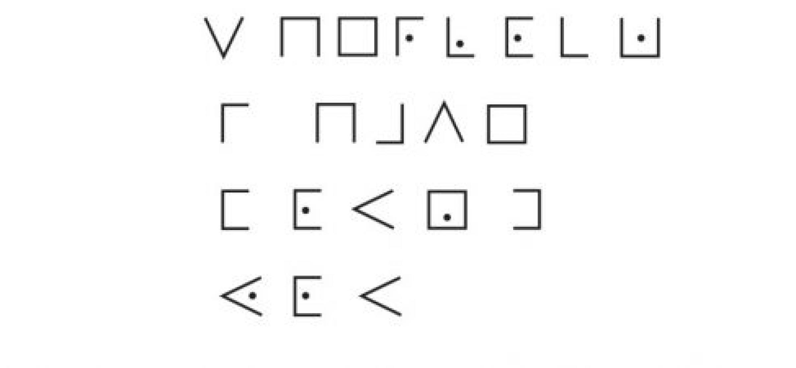
Confidentiality
Probably what you think of with “security”. Prevents someone from reading your messages.

Slide 3
Why is confidentiality alone not enough?
Attacker can modify information without needing to know the contents.
Attack the fort at dawn.
Meet me at nightfall by the tower.
Jccjlt cqn oxac jc mjfw.
Vnnc vn jc wrpqcojuu kh cqn cxfna.

Slide 4
Jccjlt cqn oxac jc mjfw.
Vnnc vn jc wrpqcojuu kh cqn cxfna.
Jccjlt cqn oxac jc wrpqcojuu kh cqn cxfna.
Attack the fort at nightfall by the tower.

Slide 5
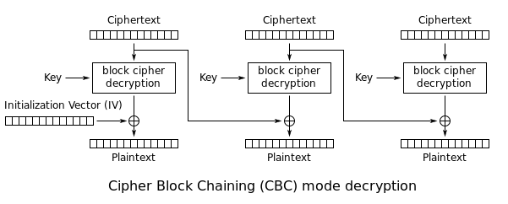
“Real” Example: AES-CBC Attack
We’ll be coming back to what AES is – but this figure shows the flow. Assume attacker has ciphertext (encrypted data) access only.

Slide 6
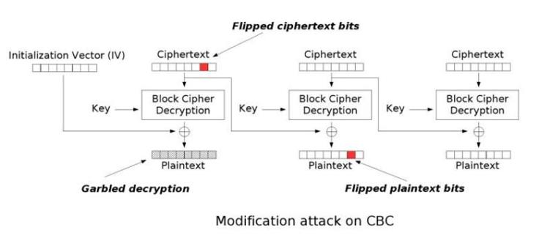
Flipping a bit here…

Slide 7
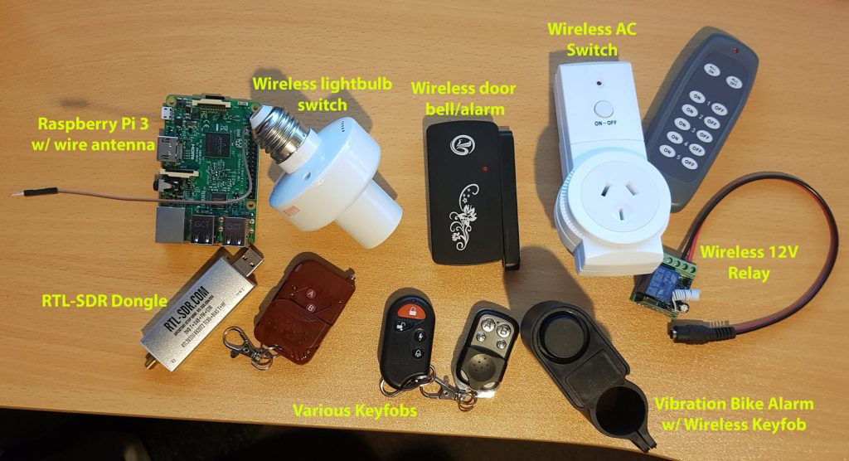
Related Attacks – Replay Attacks
If you have an “unlock message” – can you just resend it?
https://www.rtl-sdr.com/tutorial-replay-attacks-with-an-rtl-sdr-raspberry-pi-and-rpitx/

Slide 8
Time of Check Time of Use (TOC/TOU)
Verify identity of file at point A.
Use file at Point B, where the file could change inbetween.
Following example from:
https://www.usenix.org/sites/default/files/conference/protected-files/michele_woot12_slides.pdf
https://www.usenix.org/conference/woot12/workshop-program/presentation/mulliner

Slide 9
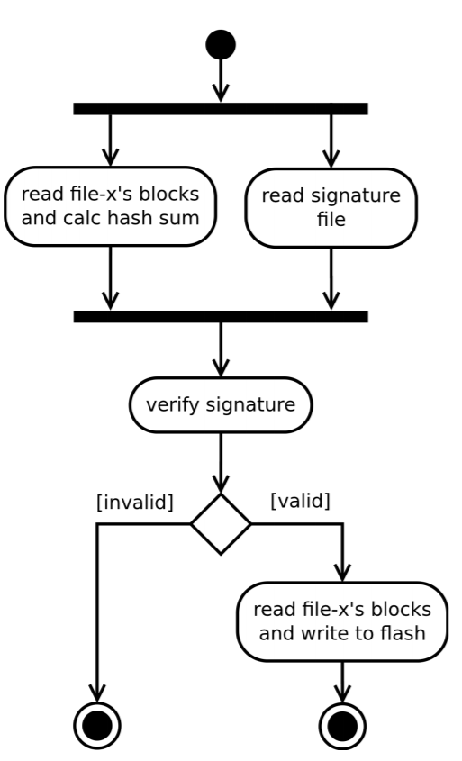
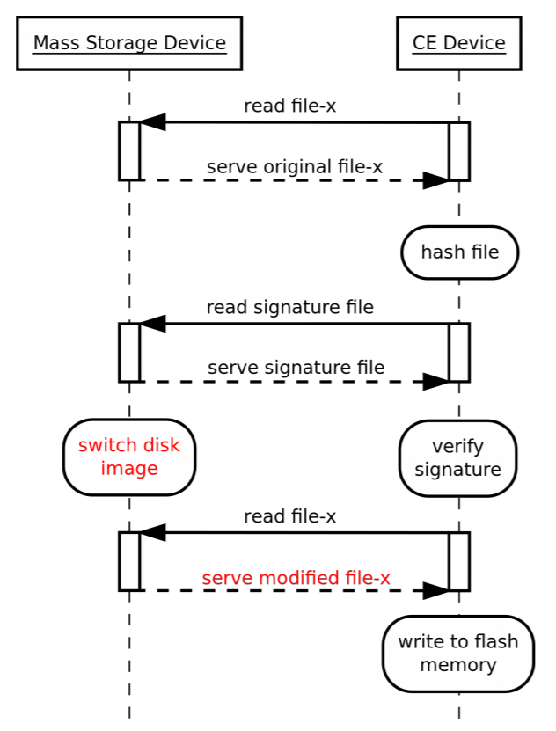
Related Attack – TOC/TOU
Time of Check → File is checked to be OK.
Time of Use → File is actually used (but not checked again).

Slide 10
Confidentiality
Confidentiality is an important part of security.
Confidentiality alone is almost always insufficient for a secure system.

